Slide 1
Employee Data Analysis using Excel
STUDENT NAME:PAVITHRA.E
REGISTER NO:312214569/A87A7335CBD2468850742C533DDF8F12
DEPARTMENT:DEPARTMENT OF COMMERCE
COLLEGE:ST.THMOMAS COLLEGE OF ARTS AND SCIENCE

Slide 2
PROJECT TITLE
Employee Performance Analysis using Excel

Slide 3


AGENDA
Problem Statement
Project Overview
End Users
Our Solution and Proposition
Dataset Description
Modelling Approach
Results and Discussion
Conclusion
3/21/2024 Annual Review

Slide 4

PROBLEM STATEMENT
In our organization, employee attendance is critical to maintaining productivity and ensuring smooth operations. However, the current approach to monitoring and analyzing attendance is primarily manual and lacks a structured, visual method for identifying trends and patterns

Slide 5

PROJECT OVERVIEW
.
1)To automate the analysis of employee attendance data.2)To create easy-to-understand Excel charts that visualize trends in attendance over time.3)To provide management with actionable insights that support decision-making related to employee scheduling, leave policies, and interventions for improving attendanc

Slide 6

WHO ARE THE END USERS? 1Human Resources (HR) and Managers 2Team Leaders and Managers 3Senior Management and Executives 4Operations and Planning Teams 5Finance Department 6Employee Relations or Engagement Teams7Employees

Slide 7

OUR SOLUTION AND ITS VALUE PROPOSITION
Our solution offers a comprehensive approach to visualizing employee attendance trends using Excel charts. By integrating data analysis with clear graphical representations, we make it easier for organizations to monitor attendance patterns and identify trends over time

Slide 8
DATASET DESCRIPTION Employee= KAGGLE 26-Features 9-Features Emp Id- Number Name TextEmp- Type Current Employee Rating- Number Gender- Male FemaleEmployee Rating -NumberDATA

Slide 9

THE “WOW” IN OUR SOLUTION =IFS(Z8>=5,”VERY HIGH”,Z8>=4,”HIGH”,Z8>=3,”MED”,TRUE,”LOW”)
3/21/2024 Annual Review
9

Slide 10
MODELLING
Dynamic Charts: Use line charts or area charts to show trends over time.
These can help you easily identify patterns and fluctuations in attendance.
Conditional Formatting: Highlight specific data points or ranges using color scales or data bars.
For instance, you might use a gradient to show attendance levels, with high attendance in green and low in red.
10

Slide 11
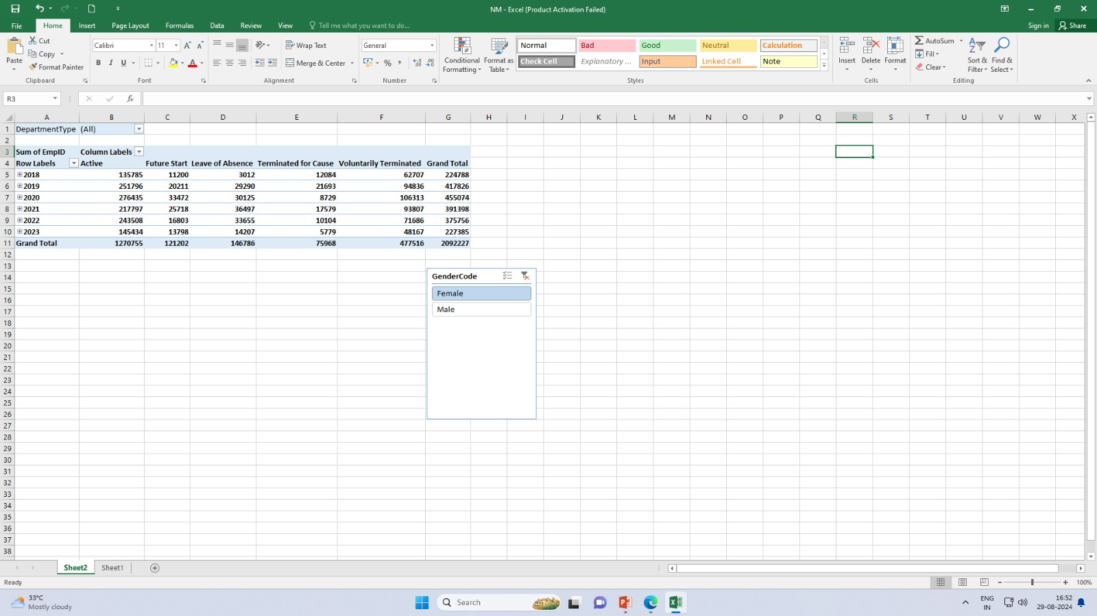
RESULTS

Slide 12
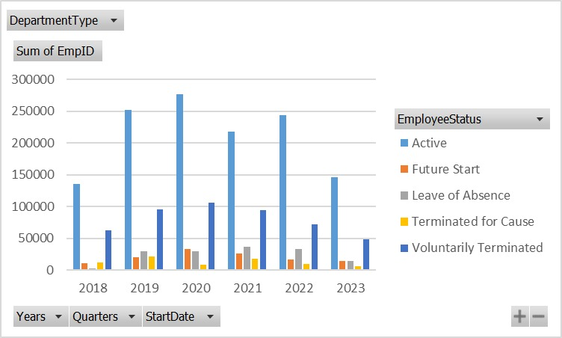
RESULTS
12

Slide 13
conclusion
"In conclusion, our analysis of employee data using Excel has provided valuable insights into our organization's workforce. By leveraging Excel's data analysis capabilities, we were able to identify trends, patterns, and correlations within our employee data, including [briefly mention some key findings, e.g., "areas of high turnover, opportunities for training and development, and disparities in compensation"].
These findings have significant implications for our organization's strategic planning, talent management, and decision-making processes. By applying the insights gained from this analysis, we can:- Improve employee retention and engagement- Optimize training and development programs- Enhance diversity, equity, and inclusion initiatives- Inform data-driven decisions on compensation and benefits

